Slide 1
Conflict
Conflict Defined
  Is a process that begins when one party perceives that another party has negatively affected, or is about to negatively affect, something that the first party cares about.
    Is that point in an ongoing activity when an interaction “crosses over” to become an interparty conflict.
  Encompasses a wide range of conflicts that people experience in organizations
    Incompatibility of goals
    Differences over interpretations of facts
    Disagreements based on behavioral expectations
14–<number>
© 2005 Prentice Hall Inc. All rights reserved.

Slide 2
Approach – Approach Conflict
Approach avoidance Conflict ambivalence)
Avoidance -Avoidance Conflict
14–<number>
© 2005 Prentice Hall Inc. All rights reserved.

Slide 3

Transitions in Conflict Thought
Traditional View of Conflict
The belief that all conflict is harmful and must be avoided.
Causes:
Poor communication
Lack of openness
Failure to respond to employee needs
14–<number>
© 2005 Prentice Hall Inc. All rights reserved.

Slide 4

Transitions in Conflict Thought (cont’d)
Human Relations View of Conflict
The belief that conflict is a natural and inevitable outcome in any group.
Interactionist View of Conflict
The belief that conflict is not only a positive force in a group but that it is absolutely necessary for a group to perform effectively.
14–<number>
© 2005 Prentice Hall Inc. All rights reserved.

Slide 5
Functional versus Dysfunctional Conflict
Functional Conflict
Conflict that supports the goals of the group and improves its performance.
Dysfunctional Conflict
Conflict that hinders group performance.
14–<number>
© 2005 Prentice Hall Inc. All rights reserved.

Slide 6

Types of Conflict
Task Conflict
Conflicts over content and goals of the work.
Relationship Conflict
Conflict based on interpersonal relationships.
Process Conflict
Conflict over how work gets done.
14–<number>
© 2005 Prentice Hall Inc. All rights reserved.

Slide 7
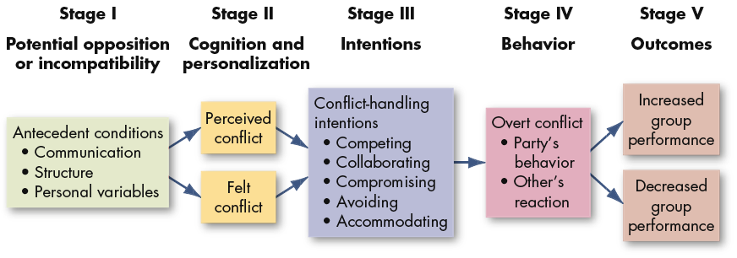
The Conflict Process
E X H I B I T 14–1
14–<number>
© 2005 Prentice Hall Inc. All rights reserved.

Slide 8
Stage I: Potential Opposition or Incompatibility
Communication
  Semantic difficulties, misunderstandings, and “noise”
Structure
  Size and specialization of jobs
  Jurisdictional clarity/ambiguity
  Member/goal incompatibility
  Leadership styles (close or participative)
  Reward systems (win-lose)
  Dependence/interdependence of groups
Personal Variables
  Differing individual value systems
  Personality types
14–<number>
© 2005 Prentice Hall Inc. All rights reserved.

Slide 9
Stage II: Cognition and Personalization
Perceived Conflict
Awareness by one or more parties of the existence of conditions that create opportunities for conflict to arise.
Felt Conflict
Emotional involvement in a conflict creating anxiety, tenseness, frustration, or hostility.
Conflict Definition
Negative Emotions
Positive Feelings
14–<number>
© 2005 Prentice Hall Inc. All rights reserved.

Slide 10
Stage III: Intentions
Intentions
Decisions to act in a given way.
Cooperativeness:
Attempting to satisfy the other party’s concerns.
Assertiveness:
Attempting to satisfy one’s own concerns.
14–<number>
© 2005 Prentice Hall Inc. All rights reserved.

Slide 11
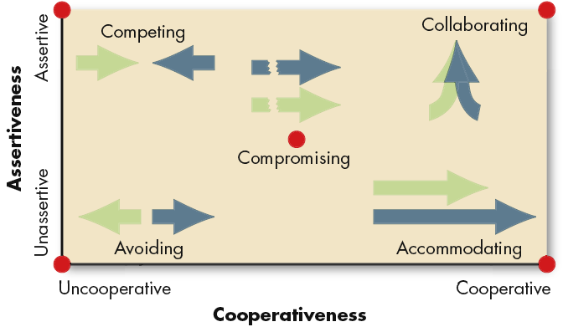
Dimensions of Conflict-Handling Intentions
Source: K. Thomas, “Conflict and Negotiation Processes in Organizations,” in M.D. Dunnette and L.M. Hough (eds.), Handbook of Industrial and Organizational Psychology, 2nd ed., vol. 3 (Palo Alto, CA: Consulting Psychologists Press, 1992), p. 668. With permission.
E X H I B I T 14–2
14–<number>
© 2005 Prentice Hall Inc. All rights reserved.

Slide 12
Stage III: Intentions (cont’d)
Competing
A desire to satisfy one’s interests, regardless of the impact on the other party to the conflict.
Collaborating
A situation in which the parties to a conflict each desire to satisfy fully the concerns of all parties.
Avoiding
The desire to withdraw from or suppress a conflict.
14–<number>
© 2005 Prentice Hall Inc. All rights reserved.

Slide 13

Stage III: Intentions (cont’d)
Accommodating
The willingness of one party in a conflict to place the opponent’s interests above his or her own.
Compromising
A situation in which each party to a conflict is willing to give up something.
14–<number>
© 2005 Prentice Hall Inc. All rights reserved.

Slide 14
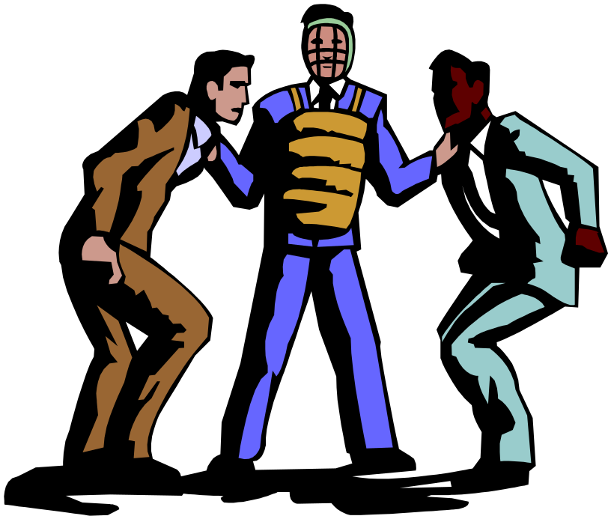
Stage IV: Behavior
Conflict Management
The use of resolution and stimulation techniques to achieve the desired level of conflict.
14–<number>
© 2005 Prentice Hall Inc. All rights reserved.

Slide 15
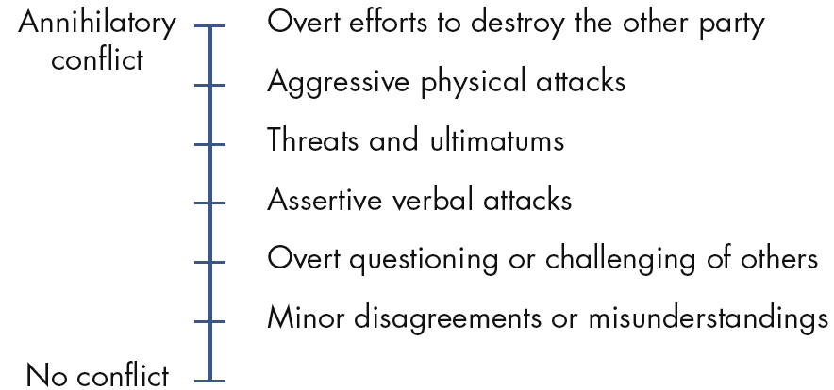
Conflict-Intensity Continuum
Source: Based on S.P. Robbins, Managing Organizational Conflict: A Nontraditional Approach (Upper Saddle River, NJ: Prentice Hall, 1974), pp. 93–97; and F. Glasi, “The Process of Conflict Escalation and the Roles of Third Parties,” in G.B.J. Bomers and R. Peterson (eds.), Conflict Management and Industrial Relations (Boston: Kluwer-Nijhoff, 1982), pp. 119–40.
E X H I B I T 14–3
14–<number>
© 2005 Prentice Hall Inc. All rights reserved.

Slide 16
Stage V: Outcomes
Functional Outcomes from Conflict
  Increased group performance
  Improved quality of decisions
  Stimulation of creativity and innovation
  Encouragement of interest and curiosity
  Provision of a medium for problem-solving
  Creation of an environment for self-evaluation and change
Creating Functional Conflict
  Reward dissent and punish conflict avoiders.
14–<number>
© 2005 Prentice Hall Inc. All rights reserved.

Slide 17
Stage V: Outcomes
Dysfunctional Outcomes from Conflict
  Development of discontent
  Reduced group effectiveness
  Retarded communication
  Reduced group cohesiveness
  Infighting among group members overcomes group goals
14–<number>
© 2005 Prentice Hall Inc. All rights reserved.

Slide 18

Negotiation
Negotiation
A process in which two or more parties exchange goods or services and attempt to agree on the exchange rate for them.
BATNA
The Best Alternative To a Negotiated Agreement; the lowest acceptable value (outcome) to an individual for a negotiated agreement.
14–<number>
© 2005 Prentice Hall Inc. All rights reserved.

Slide 19

Bargaining Strategies
Distributive Bargaining
Negotiation that seeks to divide up a fixed amount of resources; a win-lose situation.
Integrative Bargaining
Negotiation that seeks one or more settlements that can create a win-win solution.
14–<number>
© 2005 Prentice Hall Inc. All rights reserved.

Slide 20
Distributive Versus Integrative Bargaining
Bargaining Distributive Integrative
Characteristic Characteristic Characteristic
Available resources Fixed amount of Variable amount of
resources to be divided resources to be divided
Primary motivations I win, you lose I win, you win
Primary interests Opposed to each other Convergent or congruent
with each other
Focus of relationships Short term Long term
E X H I B I T 14–5
Source: Based on R. J. Lewicki and J. A. Litterer, Negotiation (Homewood, IL: Irwin, 1985), p. 280.
14–<number>
© 2005 Prentice Hall Inc. All rights reserved.

Slide 21
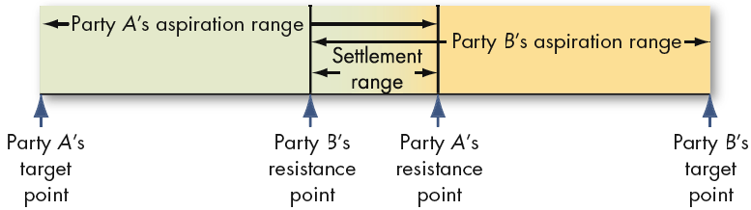
Staking Out the Bargaining Zone
E X H I B I T 14–6
14–<number>
© 2005 Prentice Hall Inc. All rights reserved.

Slide 22
Issues in Negotiation
The Role of Personality Traits in Negotiation
  Traits do not appear to have a significantly direct effect on the outcomes of either bargaining or negotiating processes.
Gender Differences in Negotiations
  Women negotiate no differently from men, although men apparently negotiate slightly better outcomes.
  Men and women with similar power bases use the same negotiating styles.
  Women’s attitudes toward negotiation and their success as negotiators are less favorable than men’s.
14–<number>
© 2005 Prentice Hall Inc. All rights reserved.

Slide 23
Why American Managers Might Have Trouble in Cross-Cultural Negotiations
Italians, Germans, and French don’t soften up executives with praise before they criticize. Americans do, and to many Europeans this seems manipulative. Israelis, accustomed to fast-paced meetings, have no patience for American small talk.
British executives often complain that their U.S. counterparts chatter too much. Indian executives are used to interrupting one another. When Americans listen without asking for clarification or posing questions, Indians can feel the Americans aren’t paying attention.
Americans often mix their business and personal lives. They think nothing, for instance, about asking a colleague a question like, “How was your weekend?” In many cultures such a question is seen as intrusive because business and private lives are totally compartmentalized.
E X H I B I T 14–8
Source: Adapted from L. Khosla, “You Say Tomato,” Forbes, May 21, 2001, p. 36.
14–<number>
© 2005 Prentice Hall Inc. All rights reserved.

Slide 24

Third-Party Negotiations
Mediator
A neutral third party who facilitates a negotiated solution by using reasoning, persuasion, and suggestions for alternatives.
Arbitrator
A third party to a negotiation who has the authority to dictate an agreement.
14–<number>
© 2005 Prentice Hall Inc. All rights reserved.

Slide 25

Third-Party Negotiations (cont’d)
Conciliator
A trusted third party who provides an informal communication link between the negotiator and the opponent.
Consultant
An impartial third party, skilled in conflict management, who attempts to facilitate creative problem solving through communication and analysis.
14–<number>
© 2005 Prentice Hall Inc. All rights reserved.

Slide 26
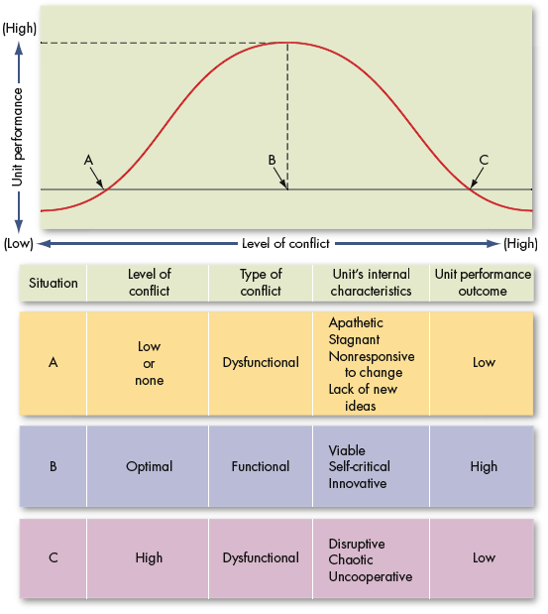
Conflict and Unit Performance
E X H I B I T 14–9
14–<number>
© 2005 Prentice Hall Inc. All rights reserved.

Slide 27
Conflict-Handling Intention: Competition
When quick, decisive action is vital (in emergencies); on important issues.
Where unpopular actions need implementing (in cost cutting, enforcing unpopular rules, discipline).
On issues vital to the organization’s welfare.
When you know you’re right.
Against people who take advantage of noncompetitive behavior.
14–<number>
© 2005 Prentice Hall Inc. All rights reserved.

Slide 28
Conflict-Handling Intention: Collaboration
To find an integrative solution when both sets of concerns are too important to be compromised.
When your objective is to learn.
To merge insights from people with different perspectives.
To gain commitment by incorporating concerns into a consensus.
To work through feelings that have interfered with a relationship.
14–<number>
© 2005 Prentice Hall Inc. All rights reserved.

Slide 29
Conflict-Handling Intention: Avoidance
When an issue is trivial, or more important issues are pressing.
When you perceive no chance of satisfying your concerns.
When potential disruption outweighs the benefits of resolution.
To let people cool down and regain perspective.
When gathering information supersedes immediate decision.
When others can resolve the conflict effectively
When issues seem tangential or symptomatic of other issues.
14–<number>
© 2005 Prentice Hall Inc. All rights reserved.

Slide 30
Conflict-Handling Intention: Accommodation
When you find you’re wrong and to allow a better position to be heard.
To learn, and to show your reasonableness.
When issues are more important to others than to yourself and to satisfy others and maintain cooperation.
To build social credits for later issues.
To minimize loss when outmatched and losing.
When harmony and stability are especially important.
To allow employees to develop by learning from mistakes.
14–<number>
© 2005 Prentice Hall Inc. All rights reserved.

Slide 31
Conflict-Handling Intention: Compromise
When goals are important but not worth the effort of potential disruption of more assertive approaches.
When opponents with equal power are committed to mutually exclusive goals.
To achieve temporary settlements to complex issues.
To arrive at expedient solutions under time pressure.
As a backup when collaboration or competition is unsuccessful.
14–<number>
© 2005 Prentice Hall Inc. All rights reserved.

